Slide 1

Chapter 22
Next Generation
IP
Copyright © The McGraw-Hill Companies, Inc. Permission required for reproduction or display.

Slide 2
    22-1 IPv6 Addressing
The main reason for migration from IPv4 to IPv6 is the small size of the address space in IPv4. In this section, we show how the huge address space of IPv6 prevents address depletion in the future. We also discuss how the new addressing responds to some problems in the IPv4 addressing mechanism. An IPv6 address is 128 bits or 16 bytes (octets) long, four times the address length in IPv4.
22.<number>
Notes:
22.#

Slide 3
22.22.1 Representation
A computer normally stores the address in binary, but it is clear that 128 bits cannot easily be handled by humans. Several notations have been proposed to represent IPv6 addresses when they are handled by humans. The following shows two of these notations: binary and colon hexadecimal.
22.<number>
Notes:
22.#

Slide 4
22.22.2 Address Space
The address space of IPv6 contains 2¹²⁸ addresses. This address space is 2⁹⁶ times the IPv4 address—definitely no address depletion—as shown, the size of the space is
22.<number>
Notes:
22.#

Slide 5
22.22.3 Address Space Allocation
Like the address space of IPv4, the address space of IPv6 is divided into several blocks of varying size and each block is allocated for a special purpose. Most of the blocks are still unassigned and have been set aside for future use. Table 22.1 shows only the assigned blocks. In this table, the last column shows the fraction each block occupies in the whole address space..
22.<number>
Notes:
22.#

Slide 6

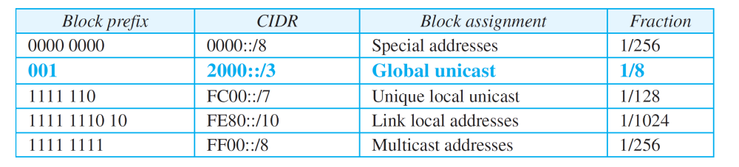
Table 22.1: Prefixes for assigned IPv6 addresses
22.<number>

Slide 7
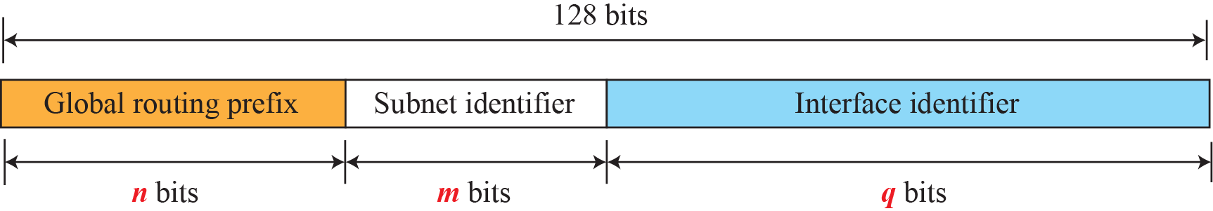
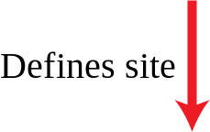
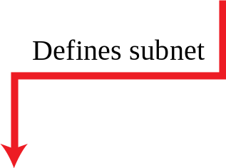
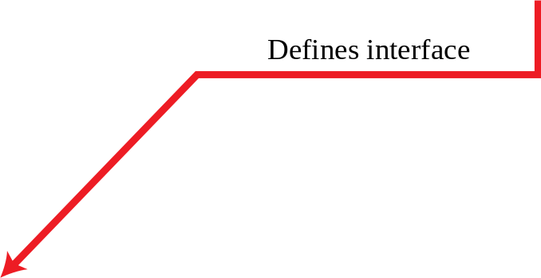
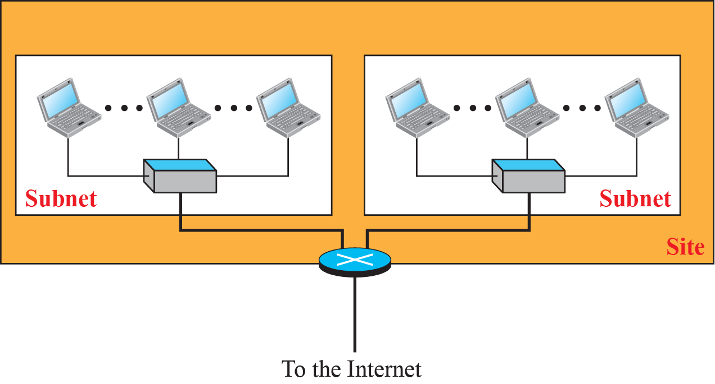
Figure 22.1: Global unicast address
22.<number>
Notes:
22.#

Slide 8
Example 22.1
An organization is assigned the global routing prefix 48 bit block as 2000:1456:2474. What is the CIDR notation for the blocks in the first and second subnets in this organization?
Solution
Theoretically, the first and second subnets should use the blocks with subnet identifier 0001₁₆ and 0002₁₆. This means that the blocks are 2000:1456:2474:0000/64 and 2000:1456:2474:0001/64.
22.<number>

Slide 9
Example 22.2
Using the format we defined for Ethernet addresses, find the interface identifier if the physical address in the EUI is
(F5-A9-23-EF-07-14-7A-D2)₁₆.
Solution
We only need to change the seventh bit of the first octet from 0 to 1 and change the format to colon hex notation. The result is F7A9:23EF:0714:7AD2.
22.<number>

Slide 10
Example 22.3
Using the format we defined for Ethernet addresses, find the interface identifier if the Ethernet physical address is
(F5-A9-23-14-7A-D2)16.
Solution
We only need to change the seventh bit of the first octet from 0 to 1, insert two octets FFFE₁₆ and change the format to colon hex notation. The result is F7A9:23FF:FE14:7AD2 in colon hex.
22.<number>

Slide 11

Example 22.4
An organization is assigned the 48 bit global routing prefix block as 2000:1456:2474. What is the IPv6 address of an interface in the third subnet if the IEEE physical address of the computer is (F5-A9-23-14-7A-D2)16?
Solution
The interface identifier for this interface is F7A9:23FF:FE14:7AD2 (see Example 22.3). If we append this identifier to the global prefix and the subnet identifier, we get:
22.<number>

Slide 12
Figure 22.4: Special addresses
22.<number>
Notes:
22.#

Slide 13
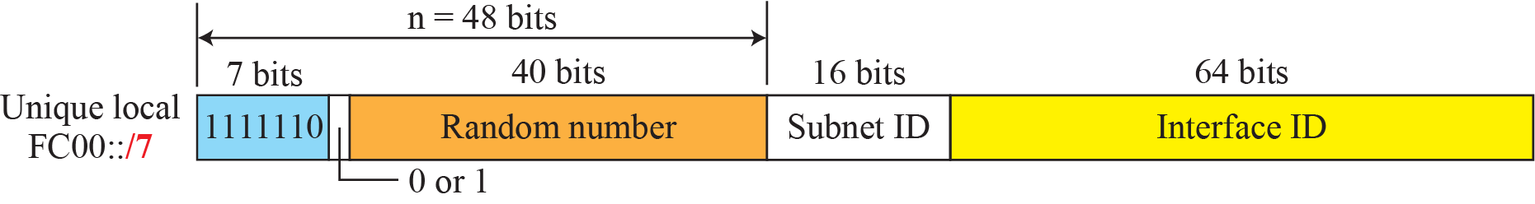
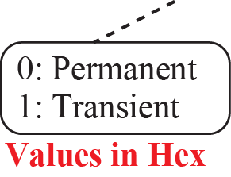
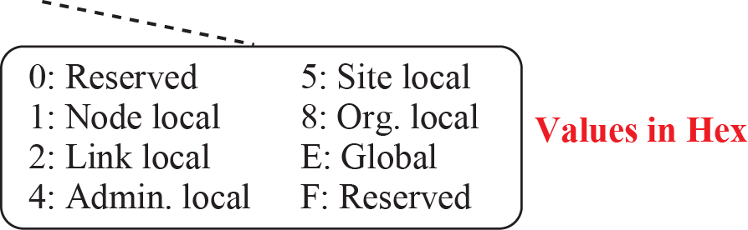
Figure 22.5: Unique local unicast block
22.<number>
Notes:
22.#
Autoconfiguration

Slide 14
    22-2 THE IPv6 PROTOCOL
The change of the IPv6 address size requires the change in the IPv4 packet format. The designer of IPv6 decided to implement remedies for other shortcomings now that a change is inevitable. The following shows other changes implemented in the protocol in addition to changing address size and format.
22.<number>
Notes:
22.#

Slide 15
22.2.1 Packet Format
The IPv6 packet is shown in Figure 22.6. Each packet is composed of a base header followed by the payload. The base header occupies 40 bytes, whereas payload can be up to 65,535 bytes of information. The description of fields follows.
22.<number>
Notes:
22.#

Slide 16
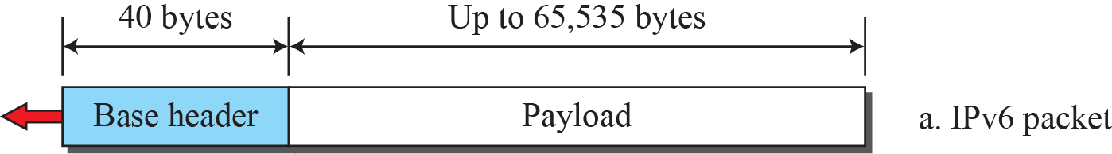
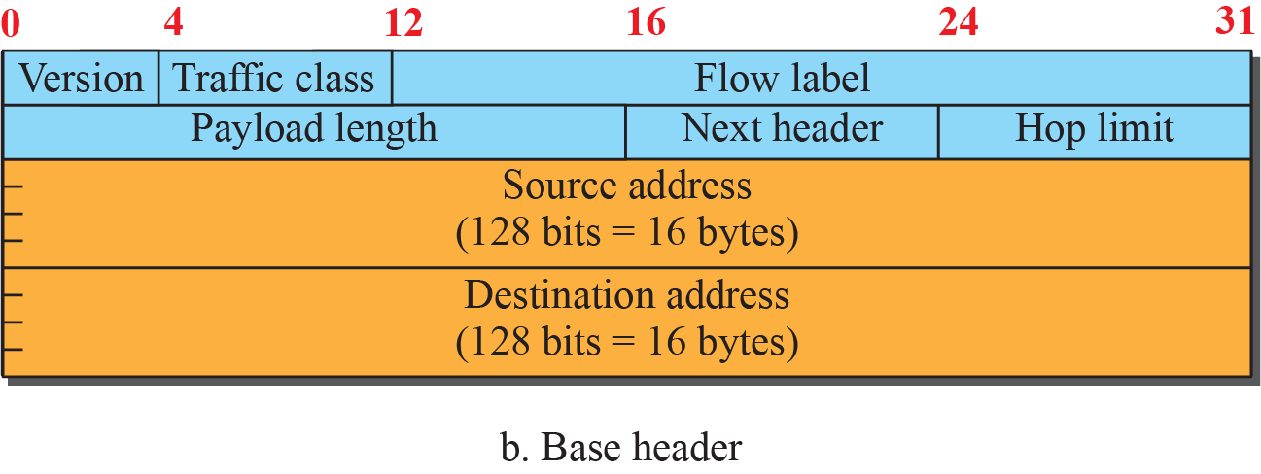
Figure 22.6: IPv6 datagram
22.<number>
Notes:
22.#

Slide 17
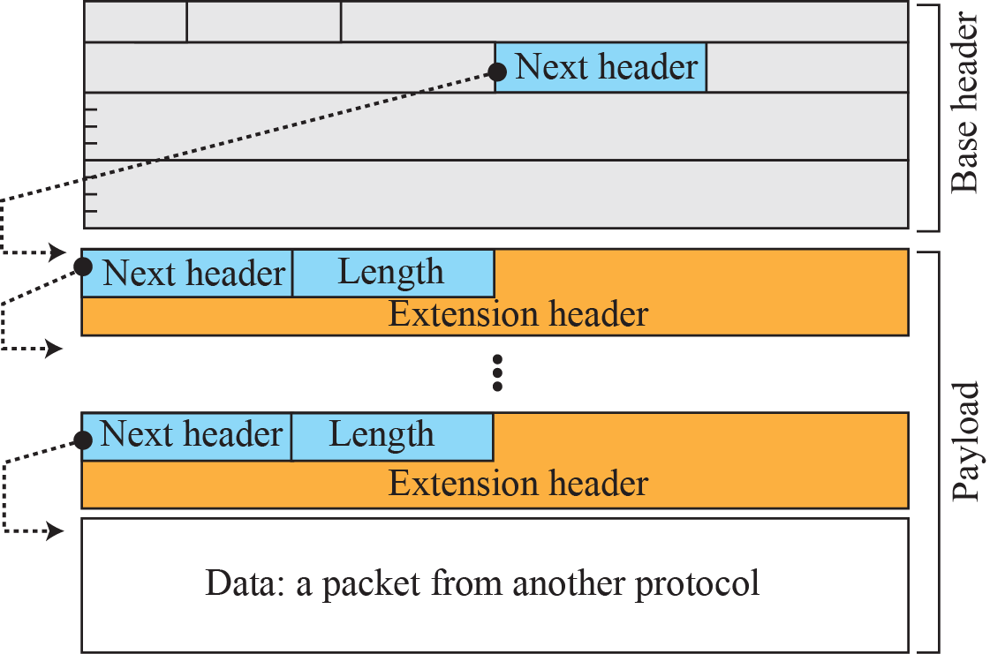
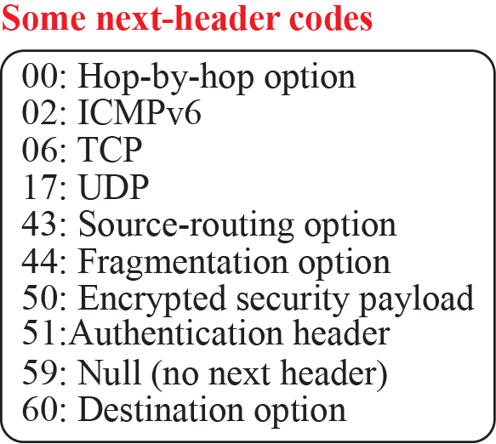
Figure 22.7: Payload in an IPv6 datagram
22.<number>
Notes:
22.#

Slide 18

Figure 20.15 IPv6 datagram header and payload
20.<number>

Slide 19

Figure 20.16 Format of an IPv6 datagram
20.<number>

Slide 20

Table 20.6 Next header codes for IPv6
20.<number>

Slide 21

Table 20.7 Priorities for congestion-controlled traffic
20.<number>

Slide 22

Table 20.8 Priorities for noncongestion-controlled traffic
20.<number>

Slide 23
22.2.2 Extension Header
An IPv6 packet is made of a base header and some extension headers. The length of the base header is fixed at 40 bytes. However, to give more functionality to the IP datagram, the base header can be followed by up to six extension headers. Many of these headers are options in IPv4. Six types of extension headers have been defined. These are hop-by-hop option, source routing, fragmentation, authentication, encrypted security payload, and destination option (see Figure 22.8).
22.<number>
Notes:
22.#

Slide 24

Figure 20.17 Extension header types
20.<number>

Slide 25

Table 20.9 Comparison between IPv4 and IPv6 packet headers
20.<number>

Slide 26
    22-4 TRANSITION FROM IPv4 TO IPv6
Although we have a new version of the IP protocol, how can we make the transition to stop using IPv4 and start using IPv6? in the Internet can move The transition must be smooth to prevent any problems between IPv4 and IPv6 systems.
22.<number>
Notes:
22.#

Slide 27
22.4.1 Strategies
Three strategies have been devised for transition: dual stack, tunneling, and header translation. One or all of these three strategies can be implemented during the transition
period..
22.<number>
Notes:
22.#

Slide 28
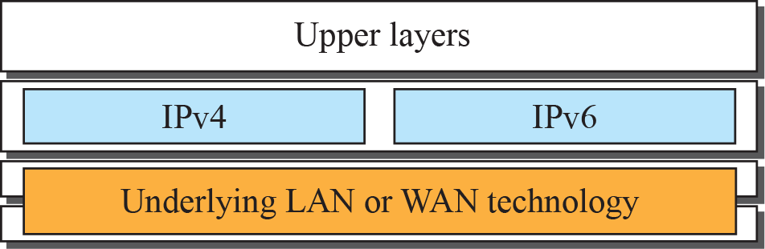




Figure 22.11: Dual stack
22.<number>
Notes:
22.#

Slide 29
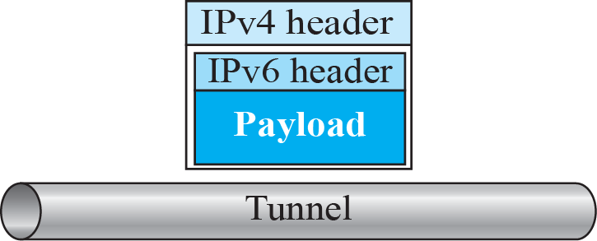
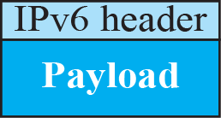
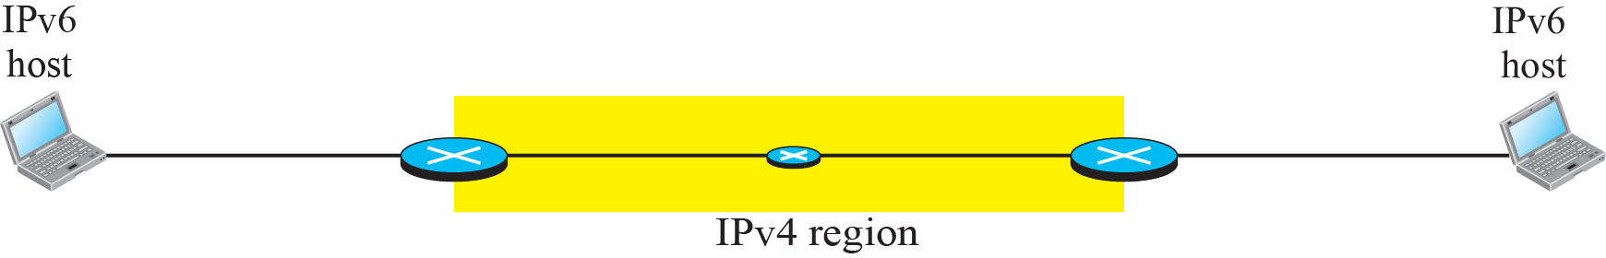
Figure 22.12: Tunneling strategy
22.<number>
Notes:
22.#

Slide 30
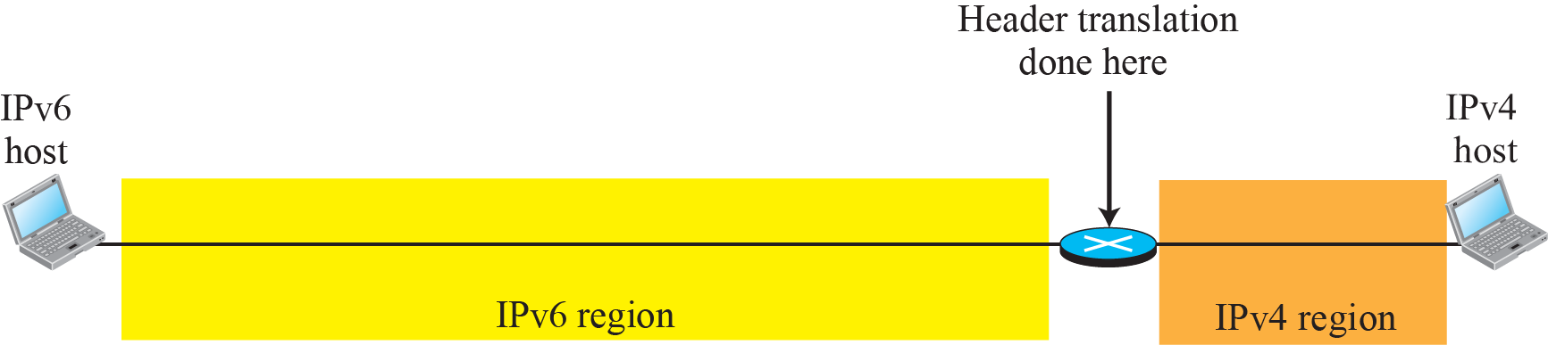
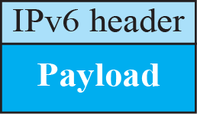
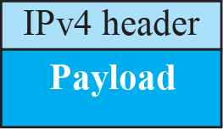
Figure 22.13: Header translation strategy
22.<number>
Notes:
22.#

